Slide 1
Income & Spending Survey Analysis
Data Collection and Insights for Healthcare Product Launch
Presented by: Adaora Nkemdilim Okafor
BAN6420 Final Project: Flask Healthcare Application
20th September 2025

Slide 2
Project Overview
Objective: Collect and analyze income and spending habits.
Methodology:
Data collected with Flask web app
Stored in MongoDB
Processed with Python (pandas, matplotlib)
Deliverable: Insights for client decision-making

Slide 3
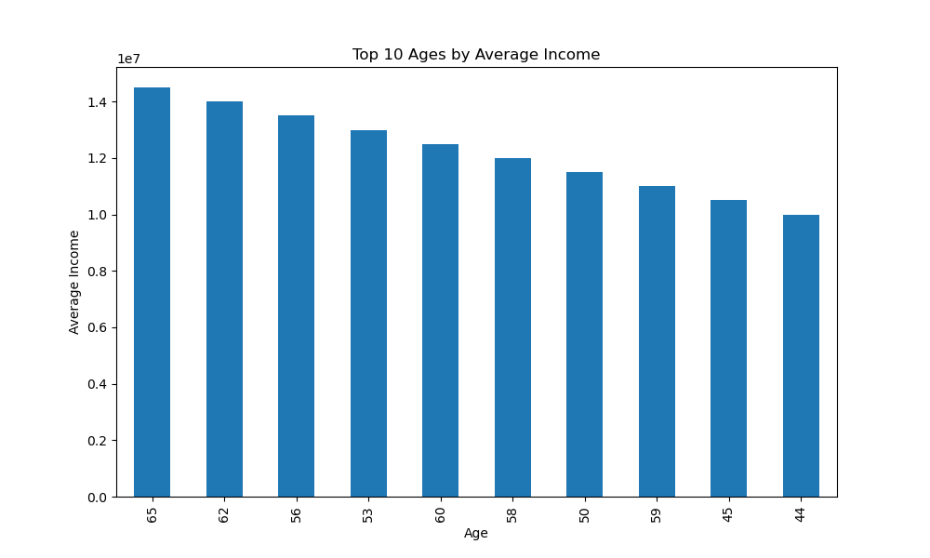
Age vs Average Income
Respondents aged 35–40 show the highest average income

Slide 4
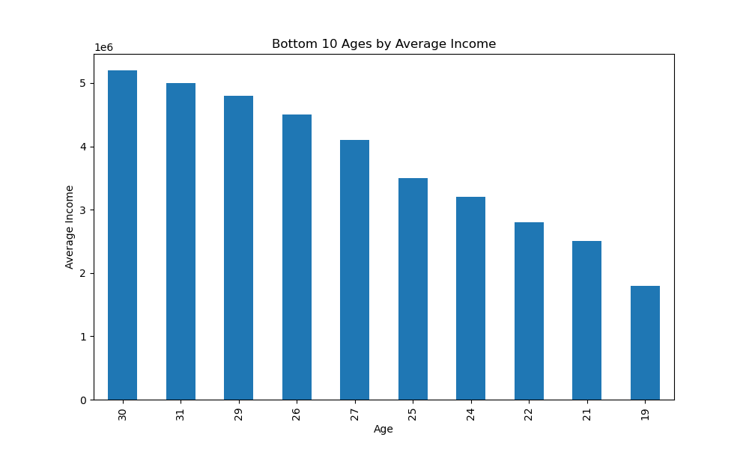
Age vs Average Income
Younger respondents (<25) and older respondents (>50) report lower income

Slide 5
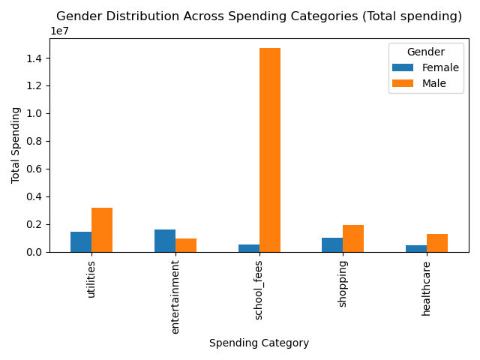
Gender Spending Distribution
Females spend more on healthcare and school fees.
Males spend more on entertainment.
Utilities and shopping are balanced across genders.

Slide 6
Key insights
Income: Highest among mid-30s to early 40s
Spending Patterns: Clear gender differences in allocation
Opportunities:
Target healthcare products toward women
Entertainment-related offers could be male-focused

Slide 7
Key insights
Focus product marketing on 30–40 age group (higher disposable income)
Tailor promotions on:
Healthcare packages → Female respondents
Entertainment/lifestyle offers → Male respondents
Explore bundled offers that combine shopping and utilities

Slide 8
Thank You

